Slide 1
Configuration Management
OpenCM
Håkan Hansson
INPRO
Global Competency Center

Slide 2






Configuration Management
“CM” Activities
Runtime Environment
Installations
Configurations
Deployments
Auditing & Verifications
Consultants
Operations
Testers
Developers
Mainteance Admins
3rd Level support
Config Properties
Config Properties
Config Properties
Pitfalls:
Discrepancies – Stale info
Incomplete
Same info in multiple places
Not executable
Time consuming audits
Large effort to maintain
Strict Governance Procedures
Traditional Formats:
Word Documents
Excel Spreadsheets
Visio
Wiki
Configuration Repository
Notes:
Installation: endpoints (server-ports-users for UM, MWS, TC, DB, UM, SPMs, EGs, LDAP, etc.), JVM sizing, Extended Settings, Central users, SSL settings, TC settings, etc. Fixes
Configurations: Extended Settings, UM configurations, proxy definitions, TC configurations, Users, Groups and ACLs, and general tweaking. Fixes
Deployments: Adapter connections, UM assets (queues & channel properties), WS endpoints, users, groups

Slide 3

Configuration Management
Derived Requirements
Runtime Environment
Single ”Source of Truth”
Automatic Baselining
Configuration Repository
Reporting
Scripted Provisioning
Change Traceability
Scripted Configuration
Automatic Audits
Scripted Deployments
Notes:
Green indicates current capabilities

Slide 4
WHY OPENCM?
Existing Product Capabilities
Configuration Governance
Repositories
Runtime Automation
Business Process Models
Capabilities & Process Flows
Level of Detail
Landscape Models & Definitions
Architecture Blueprints
Logical Views + Physical Views
ARIS
Infrastructure Configuration Items
Network components
Server components
Operating System
File Systems
Alfabet
CI
Repository
CM Automation
CMDB
Platform-Product Configuration Items
wM components
Endpoint Connections
Users - Groups
Ports
Settings
Command Central
CV Team Server
Solution Configuration Items
Packages
Queues – Topics
Adapter Connections
Deployer

Slide 5

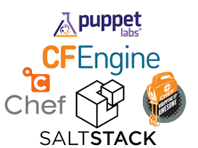









Configuration Management
SoT in a Change management Context
Operations
Targets
Orchestration
Automation
Provisioning
Configuration
Extraction
PROD
CM Repository
Command Central
PRE-PROD
Deployer
Docker
UAT
Blueprints
synch
CMDB
Other
TEST
VCS
BUILD
Development
Development

Slide 6
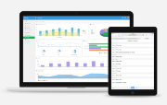
Configuration Management
Introducing “OpenCM”
Targets
Orchestration
Automation
Provisioning
Configuration
Extraction
PROD
Command Central
PRE-PROD
CM SoT – OpenCM package (IS)
Deployer
Docker
UAT
File System
Other
TEST
VCS
BUILD
Capabilities
Baselining (env extractions)
Visualization of SoT
Auditing (compare env and comp SoT)
API for Provisioning & Configuration
On-demand baseline changes
On-demand env changes
Reporting (comm contracts)
...
Blueprints

Slide 7
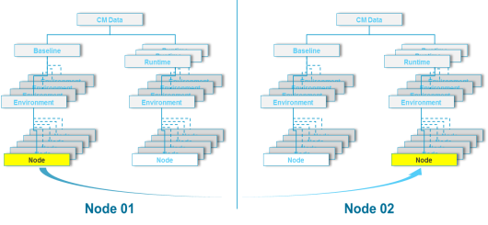


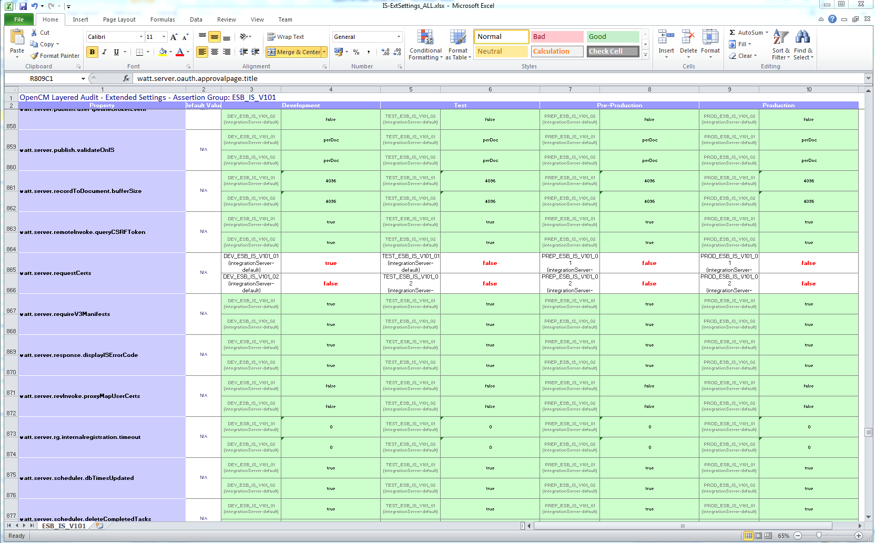
OpenCM Overview
Current: for Auditing & Asserting Correctness
Runtime Environments
OpenCM
Configuration Repository
Automated
Extract
Compare
Report

Slide 8
OpenCM
Auditing Overview – 2 step process
API
Get Property (based on json path)
Set Property – SoT (and env)
Get X Lists (env, servers, nodes, etc.)
...
Targets
Target Runtime API’s
ENV
Services
Snapshot generation (extract & store)
Promote snapshot to baseline
Compare with baseline (audit)
Compare with runtime (audit)
Compare with defaults (audit)
Search for property
Create report(s) – audit trail, comm contracts, etc.
...
Command Central
OpenCM
Custom scripts
ENV
Automation
Other
ENV
Baseline
Runtime
Auditing Runtime vs Baseline
Baselining
Auditing Runtime Differences

Slide 9
OpenCM
Extractions
Targets
IS
SPM
INST
UM
…
Products, fixes, server information & Individual properties
IS
SPM
INST
UM
…
Integration Server (Administration)
IS
Other
INST
OpenCM (IS Package)
Ext. (IS)
SPM
UM
…
Baseline FS
Runtime FS
Snapshot
Snapshot
Snapshot
Snapshot
Notes:
Other: IS package information, Adapter connection information, JCE policy

Slide 10
OpenCM
Meta-Model
Organisation
UI – Overview View
Department
Environment
Layer
Server
(Installation) Node
UI – Detailed View
Component
Instance
Property

Slide 11
OpenCM
2-Node Assertions
CM Data
CM Data
Baseline
Runtime
Baseline
Runtime
Runtime
Runtime
Runtime
Runtime
Environment
Environment
Environment
Environment
Environment
Environment
Environment
Environment
Environment
Environment
Environment
Environment
Environment
Environment
Environment
Environment
Node
Node
Node
Node
Node
Node
Node
Node
Node
Node
Node
Node
Node
Node
Node
Node
Node
Node
Node
Node
Node 01
Node 02

Slide 12
OpenCM
Comparing with Default Properties
CM Data
Reference Data
Baseline
Runtime
Runtime
Runtime
Version
Environment
Environment
Version
Environment
Environment
Version
Environment
Environment
Environment
Environment
Node
Node
Node
Node
Node
Node
Node
Node
Node
Node
Node
Node
Node
Node 01
Node 02

Slide 13
Configuration Management
“Layered” Audits – End Goal
Fix Comparison – Per “Layer”
Property | DEV | TEST | UAT | PreProd | PROD | MAINT
IS Core Fix | Node 01 = Fix11 Node 02 = Fix11 | Node 01 = Fix7 Node 02 = Fix7 | Node 01 = Fix7 Node 02 = Fix7 | Node 01 = Fix5 Node 02 = Fix5 | Node 01 = Fix5 Node 02 = Fix5 | Node 01 = Fix5 Node 02 = Fix5
JDBC Fix | Node 01 = Fix11 Node 02 = Fix11 | Node 01 = Fix4 Node 02 = Fix4 | Node 01 = Fix11 Node 02 = Fix11 | Node 01 = Fix11 Node 02 = Fix11 | Node 01 = Fix11 Node 02 = Fix11 | Node 01 = Fix11 Node 02 = Fix11
SPM Fix | Node 01 = Fix14 Node 02 = Fix8 | Node 01 = Fix7 Node 02 = ” ” | Node 01 = Fix7 Node 02 = Fix7 | Node 01 = Fix5 Node 02 = Fix5 | Node 01 = Fix7 Node 02 = Fix5 | Node 01 = ” ” Node 02 = ” ”
...
Resulting in e.g.:
“For all ESB instances, we need to apply IS Core Fix 11 to all but DEV”
“We also need to apply JDBC Fix 11 to TEST nodes”
…

Slide 14
OpenCM
“Layered” Audits
Assertion Group 01
Assertion Group 2
…
Assertion Group 2
CM Data
Runtime
Node
Node
Node
Node
Node
Node
Node
Node
Node
Node
Node
Node
Environment
Node
Node
Node
Environment
Environment
Environment
Assertion Group = Layer
Node
Node
Node
Node
E.g. “DMZ_EG” => Node 03, Node 07, Node 10, etc.
E.g. “ESB” => Node 01, Node 11, Node 22, etc.
E.g. “MED” => Node 04, Node 09, Node 15, etc.
Node
Runtime Properties

Slide 15
OpenCM Assets
Code & Configuration
Integration Server (Administration)
OpenCM Package
Flow Code
IS Libs
3rd Party Libs
JavaCode
UI Code
nodes
extract
Extracted Data
audit
Output
Template
Template
Empty
Template
Empty
Server Endpoints
Credentials
Which nodes
Property Info
What to compare
Html reports
Excel Reports
Notes:
Json parsing, http/ftp communication, java scripts, excel generation

